Slide 1
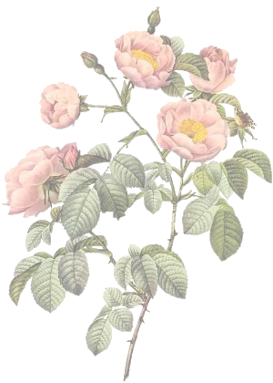
ALBERTA
WILDFLOWERS
wildflower identification app
Lisa Hynes | Stephanie Ross | Kowther Hassan
CPSC 481
Spring 2017

Slide 2
Our Design Problem
To identify, learn and share Alberta’s 100+ species of wildflowers. Enjoy all the familiarities of a traditional paper field guide, with more images and species information. Foster a community via the app, where users can share sightings, images and connect with each other
Notes:
design a system that allows people to identify wildflowers they come across, and keep track of them

Slide 3
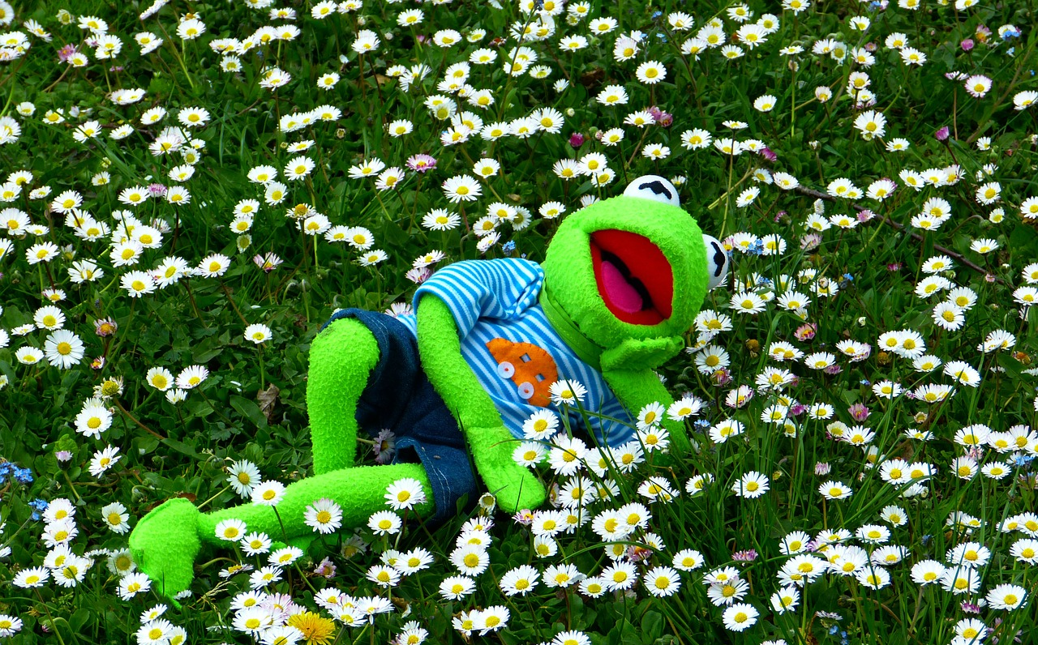
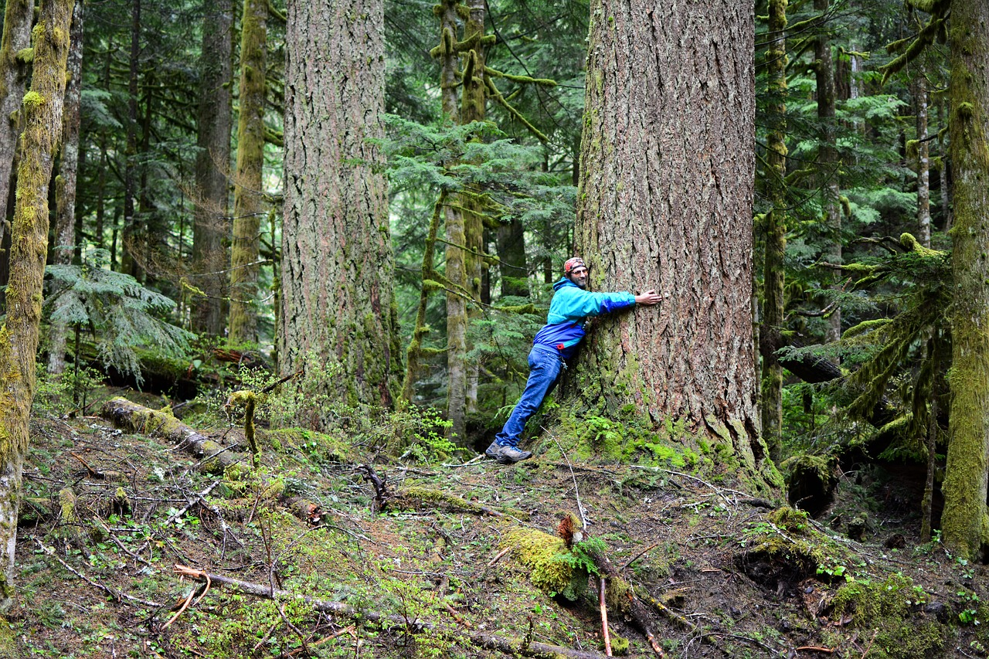
Who is the design for?
Users
Children
Casual hikers
The passionate beginner
Elderly folk
Nature enthusiasts
Stakeholders
Nature experts
Environmentalists
Notes:
Probably late elementary school age and up
Assume no prior scientific knowledge

Slide 4
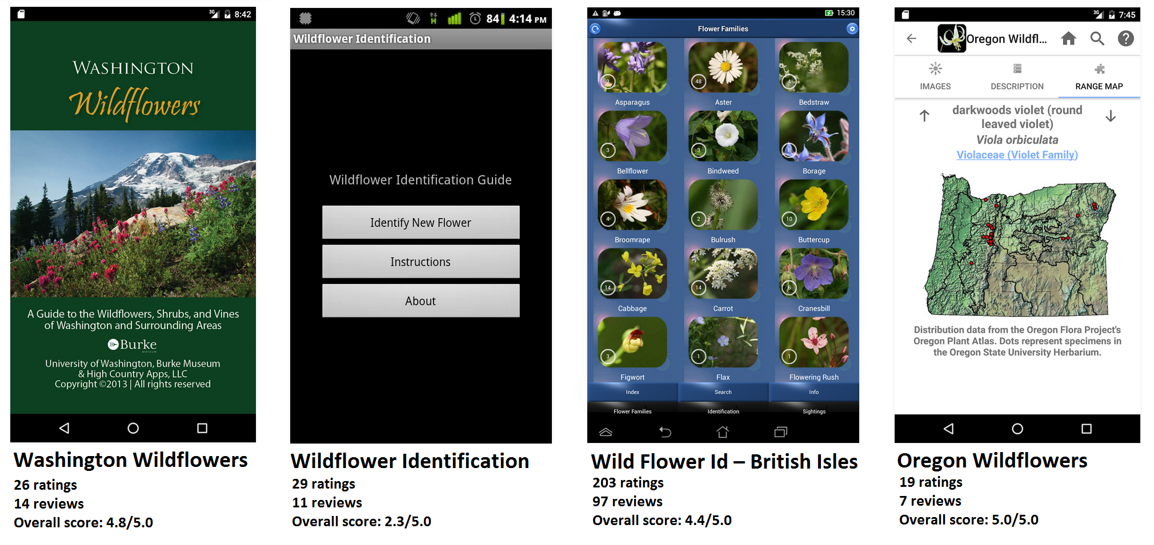
User Research Method #1: Secondary Research
Mining customer reviews of existing field guide apps
Get an idea of user preferences

Slide 5
User Research Method #1: Findings
Wide array of preferences over what users want to find out about a wildflower
Name, interesting facts vs. entire encyclopedia entry
Various levels of plant knowledge made some apps hard to learn from
Positive response to having multiple, high quality images
Enjoyed being able to narrow down results by characteristics

Slide 6
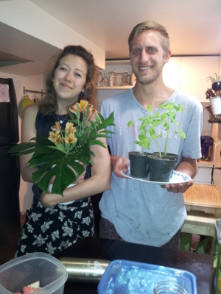
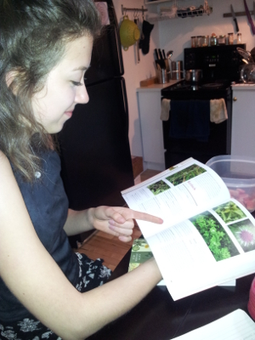
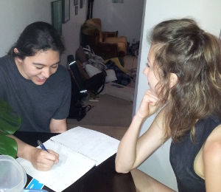
User Research Method #2: Interview
Ask nature enthusiasts about plant identification
Understand what to look for when identifying, and what is good/bad about existing resources

Slide 7
User Research Method #2: Findings
Look at colours, and shape of petal and leaves
Most people do not know plant jargon
Academic books use inaccessible language
Books vary widely in the order the plants are presented
Identification is hard because people
Unsure of what they’re supposed to be looking for
Don’t know how to describe what they see
Notes:
Sometimes identifying a flower just comes down to “this seems close enough”
Alphabetical or categories makes it hard to find
Have to buy new edition of books to get new information

Slide 8
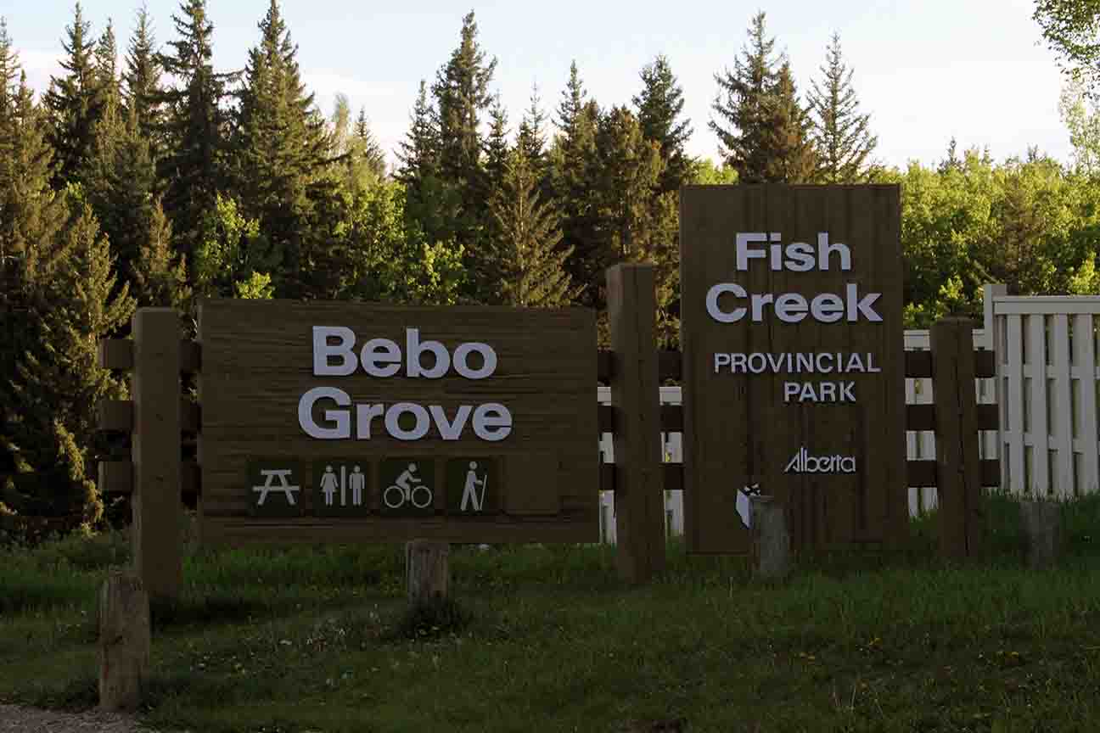
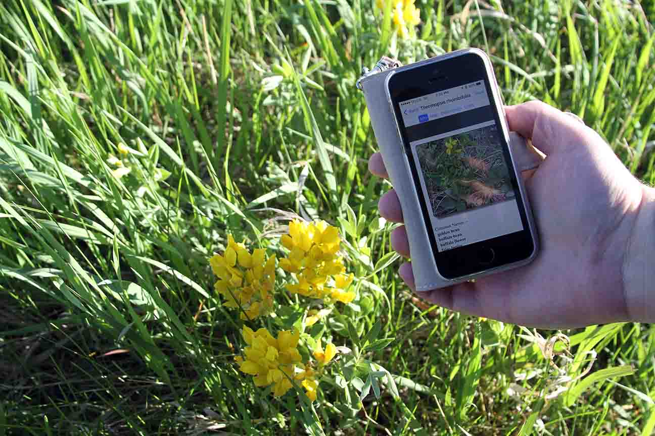
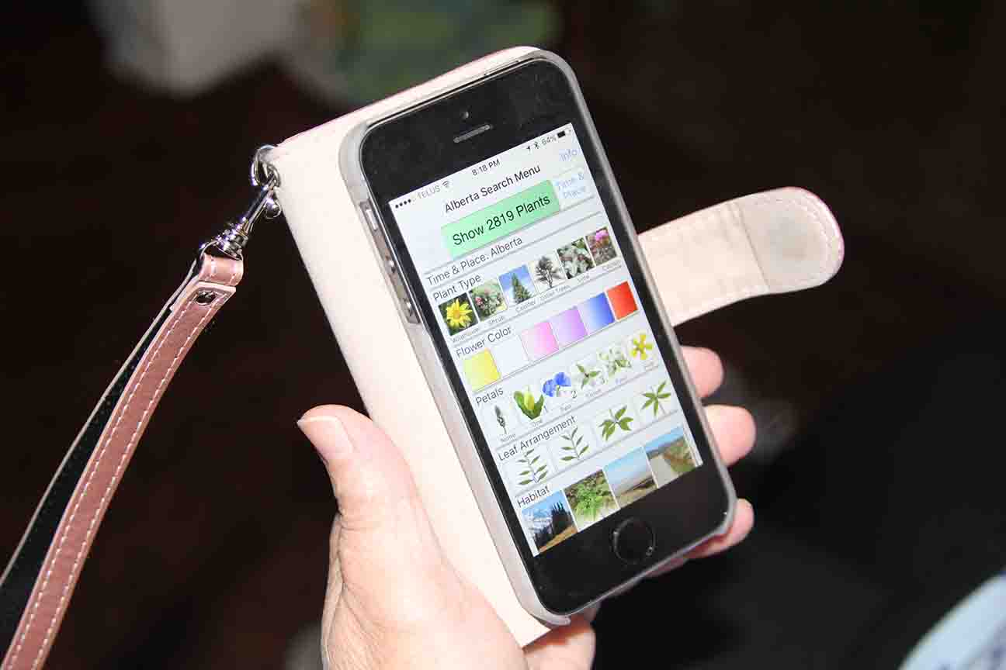
User Research Method #3: Extreme User Interview
Interact with people while they use an existing similar app
See first hand how user would be acting/feeling in the moment

Slide 9
User Research Method #3: Findings
Small/low-quality images are discouraging
High-quality images were the most helpful in determining likeness
Enjoyed being able to narrow down results by characteristics
Too many tasks on one screen is overwhelming
Cluttered layout hard to navigate

Slide 10
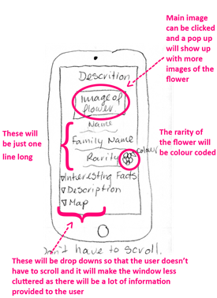
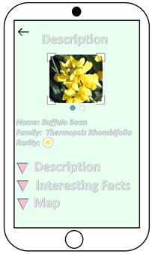
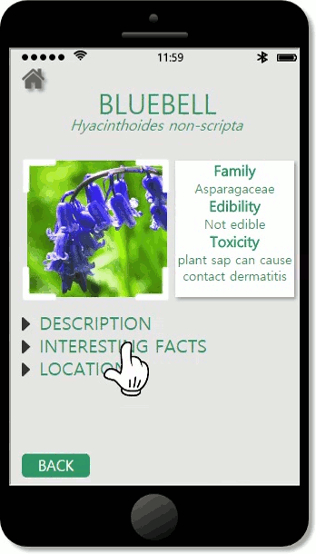
Major Design Decisions: Description Pages
Sketching
Storyboard - Low-fi Prototype
High-fi Prototype
Notes:
Justification: We found that users like a description page that is not very cluttered. The most important information should be available to the user right as they access the description page. Other more detailed information should be easily accessible by the user if they wish to learn more.

Slide 11
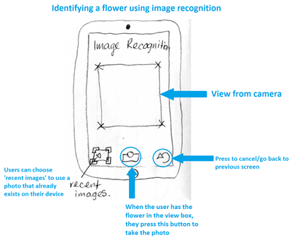
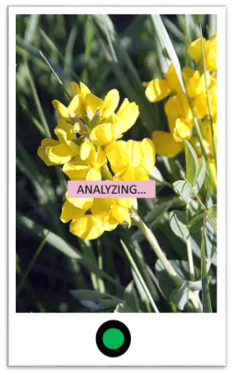
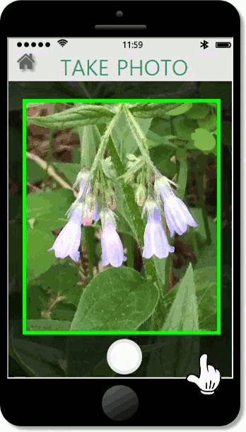
Major Design Decisions: Identification by Photo Recognition
Sketching
Storyboard - Low-fi Prototype
High-fi Prototype
Notes:
Justification: Quick one click identification method. We found that for apps who has this feature, users really liked when it worked. It significantly decreased their user experience when it didn’t…

Slide 12
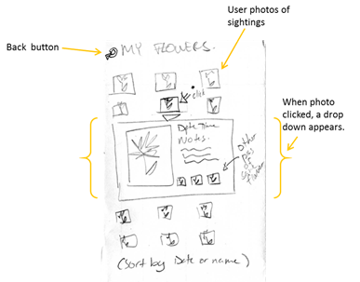
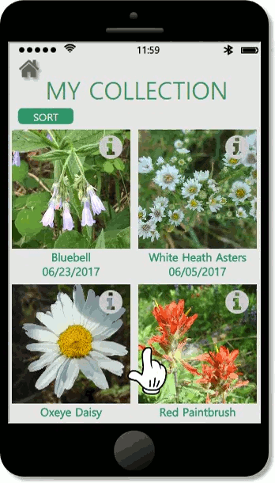
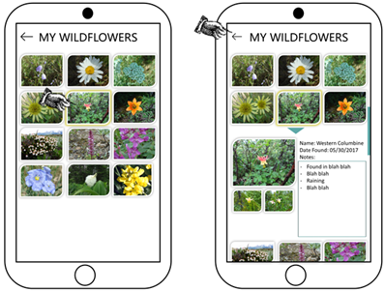
Major Design Decisions: User Log
Sketching
Storyboard - Low-fi Prototype
High-fi Prototype
Notes:
Justification: Many of the current apps do not have the option of taking and storing your own photos of wildflower sightings. Our researched showed that there is an interest in this type of feature.

Slide 13
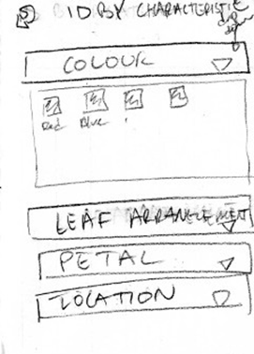
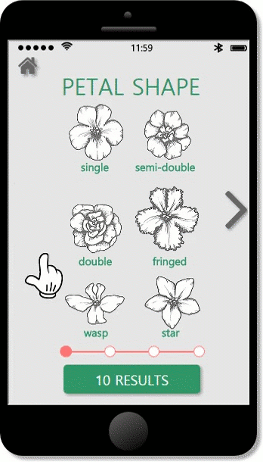
Major Design Decisions: Identification by Characteristics
Not Included
Sketching
Storyboard - Low-fi Prototype
High-fi Prototype
Notes:
Justification: Although the image recognition is the main identification technique, we felt that have this option as a failsafe was necessary.

Slide 14
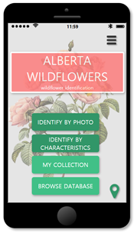
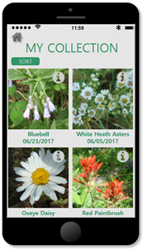
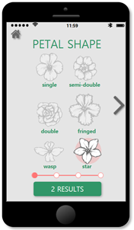
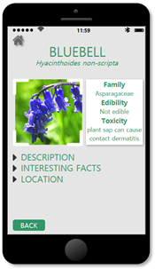
Major Design Decisions: Summary
Easy to use
large buttons, informative naming
Simple design
Reduced clutter, large buttons/clickable areas
Options!
Two identification techniques, all tasks are optional
Informative
Clear, easy to use description pages, details that users were looking for

Slide 15
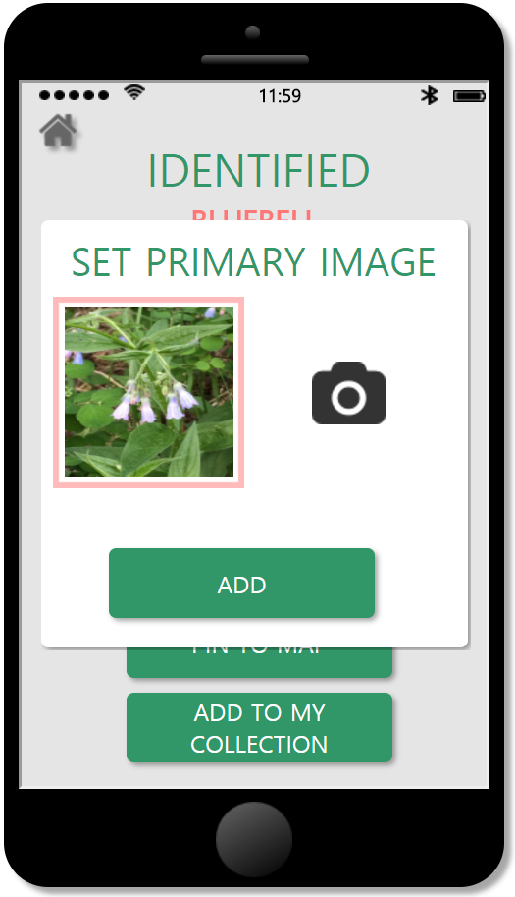
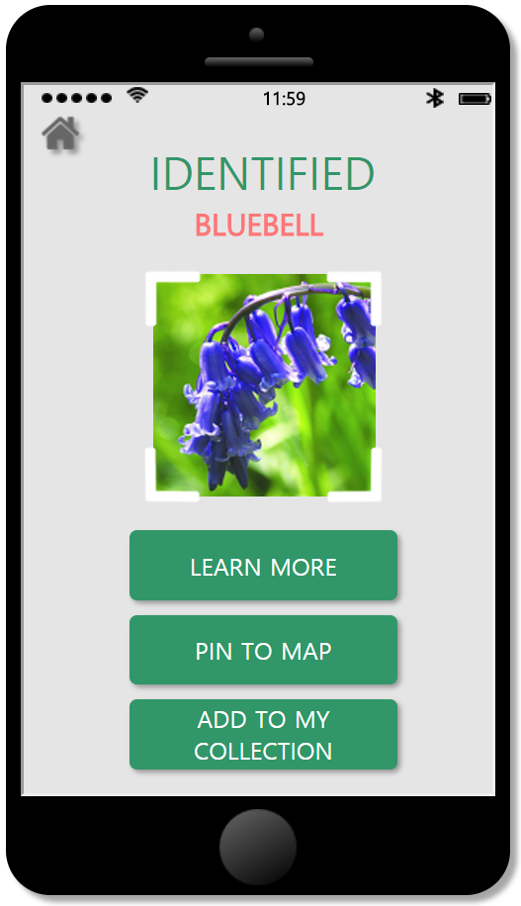
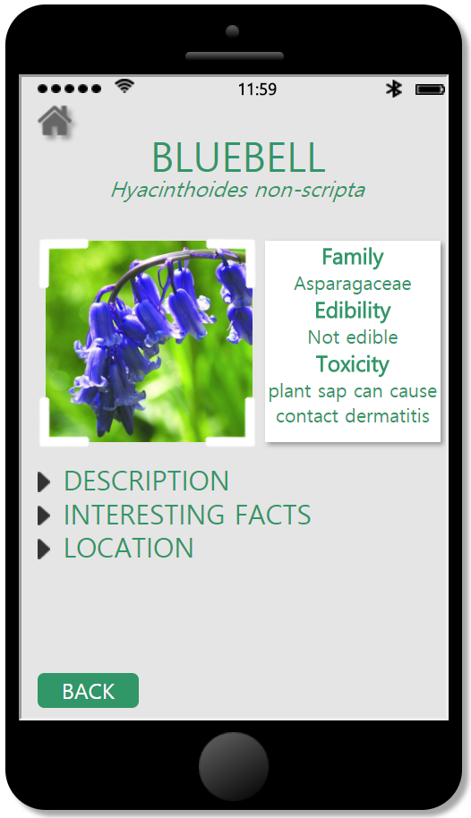
Heuristic Evaluations: Level 4 Issues
User Control and Freedom
User Control and Freedom
User Control and Freedom
Notes:
Level 4 issues. Highest severity. Must fix.
1. No close or exit or back button if user didn’t want to add to collection or has decided they don’t want to anymore
2. No back button so user cannot go back to the results if misidentified
3. Text drop downs cover back button so user can not exit screen

Slide 16
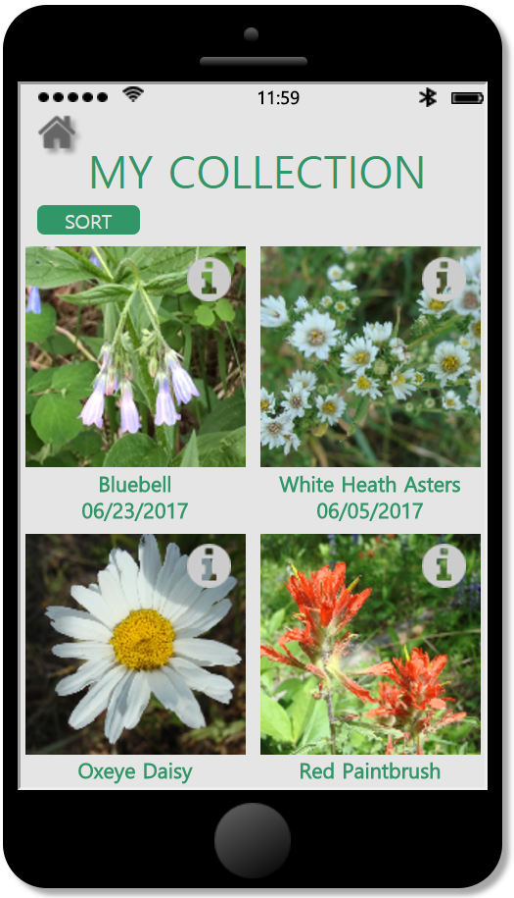
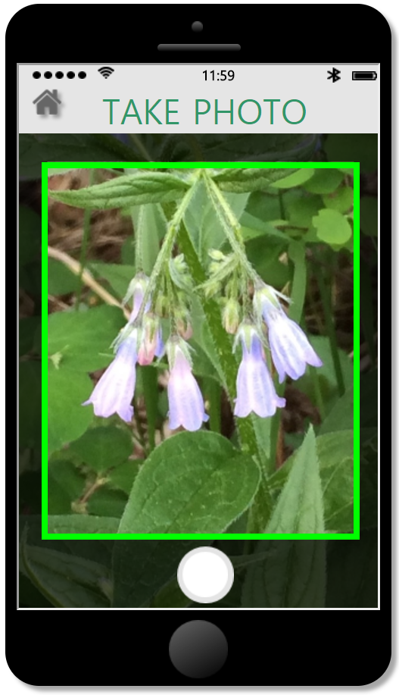
Heuristic Evaluations: Level 3 Issues
Recognition Rather than Recall / Visibility of System Status
Match Between System and Real World
Match Between System and Real World
Notes:
1. Scrolling ability is not visible to user
2. Green square still stays around image even after the image has been taken indicating the user can still take photos while it’s analyzing. Needs flash buttons.
3. Only one photo. Have multiple photos for user to look though

Slide 17
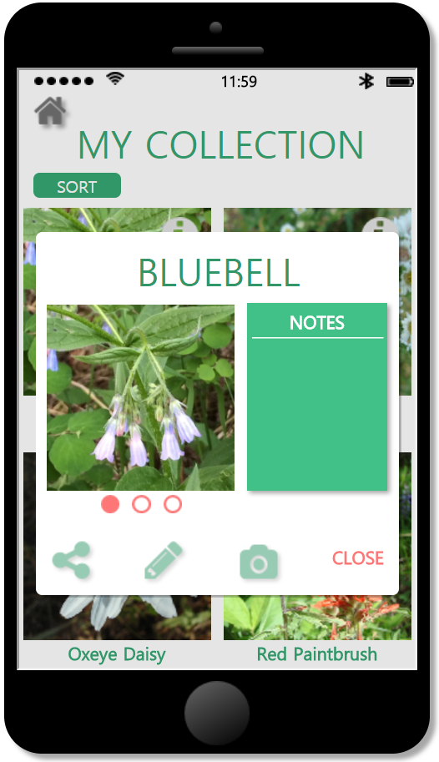
Heuristic Evaluations: Level 2 Issues
Match Between System and Real World
Visibility of System Status
Match Between System and Real World / Visibility of System Status
Notes:
1. Three circles under image indicate image swiping but have to click instead.
2. Not clear how to add, alter or delete images
3. Not clear that you can click on the image and the I button and that they take you to two different places

Slide 18
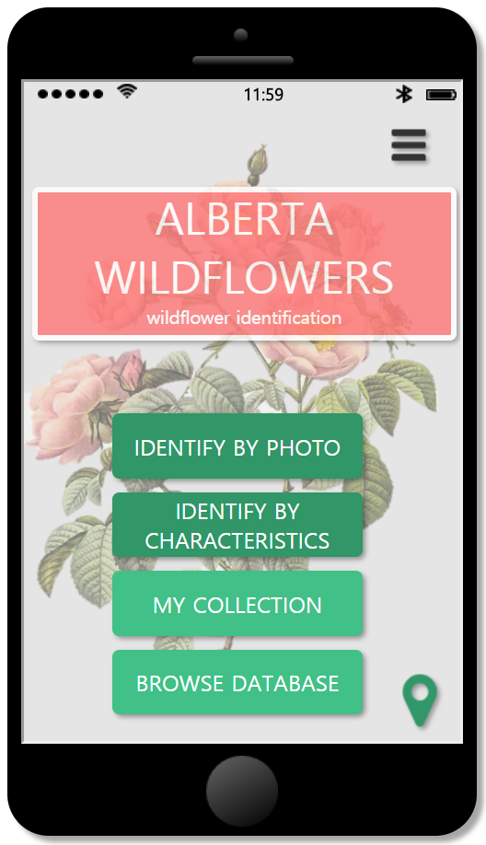
Heuristic Evaluations: Level 1 Issues
Consistency and Standards
Recognition Rather than Recall
Notes:
1. Settings button on right hand side instead of left. Also three line bar does not mean settings in the real world. Usually drop down menu instead
2. Little icons not fully clear what they do.

Slide 19

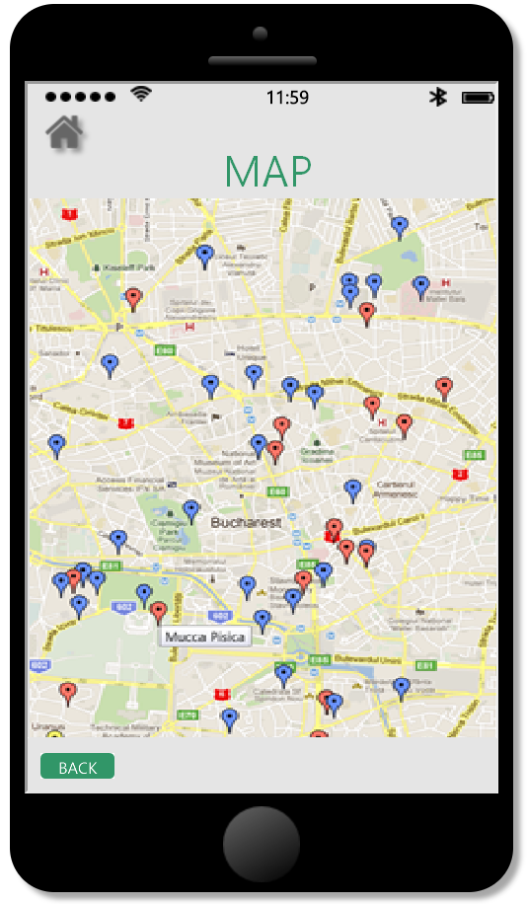
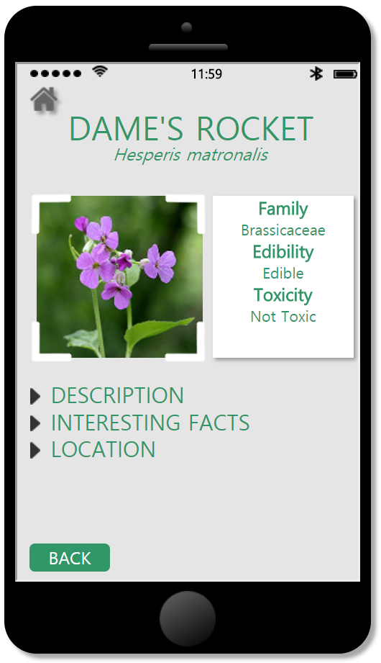
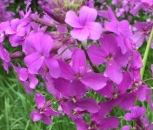

Plans for Next Iteration of the Design
Notes:
When you just want to see what’s on the map where you are standing

Slide 20
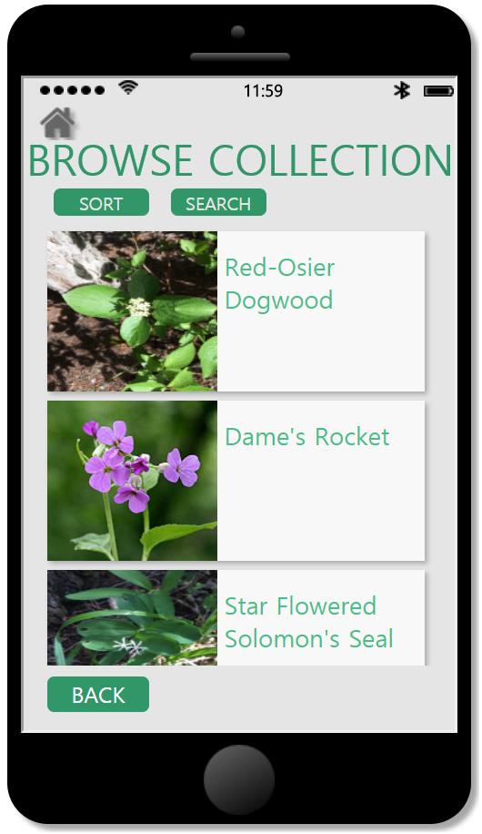
Plans for Next Iteration of the Design
Notes:
Browsing the database, sorting by name, characteristics, accessing the description page

Slide 21


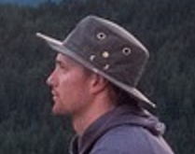

Plans for Next Iteration of the Design
CREATE PROFILE
EDIT PROFILE
Name: Brent
Location: Halifax, NS
Calgary, AB
Notes:
Settings, including creating/ editing profile. Also implement all fixes for the issues we determined in the heuristics evaluations

